Slide 1
Lesson 9
Pointers and References
By: Ryan Alterman
Revised: 10-30-17

Slide 2
What are Pointers and why use them?
Pointers make life easier
They are also necessary for certain parts of C++
Memory Locations
That is what variables are.
Each variable has a unique location that can be found using the &
What is it?
It is a variable whose value is the address of the variable
Like all variables, pointers have to be declared before you can work with them
General Form:
Type *var-name;
Regardless of type, all pointers have the same kind of value
A long hexadecimal address

Slide 3
Using Pointers
Define the pointer variable
Assign the address of a variable to a pointer
Access the value of the address at that pointer
All of this is done by the use of the * operator

Slide 4
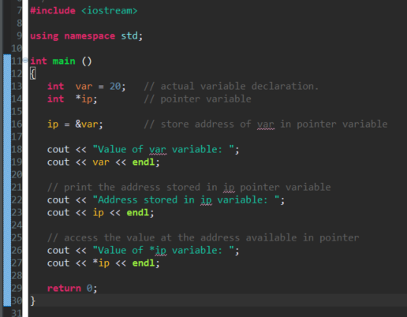
Example of Creating and using Pointers

Slide 5
Concepts of Pointers
Null Pointers
A pointer to a constant with a value of zero. Do this by setting pointer = NULL;
Pointer Arithmetic
There are only four operators that can be used on pointers. The ++, --, +, -
Pointers VS. Arrays
They are closely related. Most times that you can use one, the other is also a valid option.
Array of Pointers
You can define arrays to hold pointers
Pointer to Pointers
You can put a pointer on a pointer, so on so forth
Passing Pointers to Functions
Passing by reference or by address enable the passed argument to be changed in the calling function by the called function.
Return Pointers from Functions
Functions can return pointers

Slide 6
What are References?
It is like an alias for a variable
Once created, the original name or the new name can be use to access the variable
References VS. Pointers
They are not the same thing
You can not have a NULL reference
Once a reference has been linked, it can not be moved. Unlike pointer which can be changed whenever.
References must be created when the variable is created. Pointers can be created at any time.

Slide 7
Creating References?
Think of variables as labels for data locations
References are just a second set of labels
Form:
Type var-name = value;
type&reference-name = var-name;

Slide 8
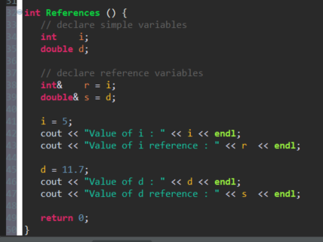
Example of References

Slide 9
Concepts of References
Usually used for:
Function argument lists
Function return values
References as parameters
C++ supports the use of references as function parameters safer than than normal parameters.
Reference as Return Values
References can be returned like any other data value.

Slide 10
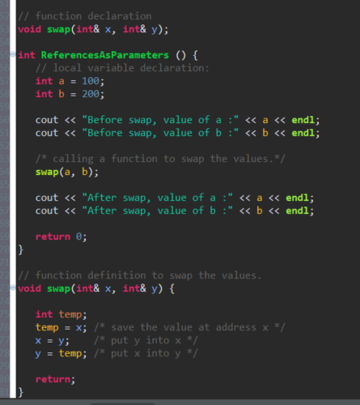
Using References as Parameters

Slide 11
Challenge
What other kinds of pointers are there? Why would we use them? When would we use references? Why? Think about a current project, how could these be implemented to make code easier?

Slide 12
Congratulations!
You have finished the FRC C++ training tutorial. There is much more about C++ that you can still learn; but for now, your FRC journey as a programmer has begun.

